Slide 1
SC2001/CE2101/CZ2101:
Algorithm Design and Analysis
Heapsort
Instructor: Asst. Prof. LIN Shang-Wei
Courtesy of Dr. Ke Yiping, Kelly’s slides
Notes:
In this section, we are going to learn another sorting algorithm called Heapsort.

Slide 2
Learning Objectives
At the end of this lecture, students should be able to:
Explain the definition and properties of a heap
Describe how Heapsort works
Explain how to construct a heap from an input array
Analyse the time complexity of Heapsort
Notes:
This week we will spend two hours learning the Heapsort algorithm. Here are the learning objectives.
First, we need to understand what is the data structure of heap. How is a heap defined, and what properties make it suitable for sorting.
Secondly, based on our understanding of the data structure, we will learn how to use a heap to do the sorting.
Thirdly, to run the Heapsort algorithm, we need to construct a heap to hold the input data in a certain order.
This is similar to the case that, in order to run Binary search, the array must be sorted. So sometimes the input data need to be pre-processed in order to run an algorithm. So we will learn how to construct a heap from an input array. Here, please note that the construction of a heap is not the sorting; rather, sorting can only be done AFTER the construction of heap has been done.
Last but not the least, we will analyze the running times of subroutines of Heapsort, including the heap construction and sorting.

Slide 3
Introduction to Heapsort
Notes:
Before going into details, let us take a look at the high level to see how Heapsort works.
So, what is the key idea behind Heapsort?

Slide 4
Heapsort
Heapsort is based on a heap data structure.
The definition of a heap includes:
  a description of the structure.
  a condition on the data in the nodes (of a binary tree) called partial order tree property.
Partial order tree property
  A tree T is a (maximising) partial order tree if and only if each node has a key value greater than or equal to each of its child nodes (if it has any).
Notes:
Heapsort is a sorting algorithm that uses the data structure approach.
The data structure used is the heap.
Hence, to understand the Heapsort algorithm, we first need to understand how data are organized in the structure of a heap.
Basically, a heap is a special type of binary tree.
In this tree, we will put the data in the tree nodes according to a rule. The rule is called “partial order tree property”. This property basically says that the father should be bigger than the sons in the tree.
Here is the definition. A tree is called a maximizing partial order tree if and only if the key value of each node is greater than or equal to the key value of each of its children node, if it has any child. Why is the “partial order tree property” important for sorting?

Slide 5
Partial Order Tree Property
9
5
8
2
4
1
6
Notes:
Here is the idea. As a result of this property, the root is the largest node in the whole tree.
We can pick up the root, delete it from the tree, and then in some way restore the partial order tree property;

Slide 6
Partial Order Tree Property
9
5
8
fix-heap
2
4
1
6
8
6
5
6
fix-heap
5
1
2
4
1
2
4
Notes:
as a result, the second largest node will pop up as the new root.
Then we can delete the new root and restore the property again, to have the third largest node as the root.
This procedure can be repeated, to pick up nodes according to their values, and thereby give them a ranking. This is the central idea of Heapsort.

Slide 7
Heapsort
Heapsort is based on a heap data structure.
The definition of a heap includes:
  a description of the structure.
  a condition on the data in the nodes (of a binary tree) called partial order tree property.
Partial order tree property
  A tree T is a (maximising) partial order tree if and only if each node has a key value greater than or equal to each of its child nodes (if it has any).
For a minimising partial order tree, the key value of every parent node is less than or equal to the value of each of its child nodes.
Notes:
We also have another version of partial order tree property, which is in the opposite direction. It is called the “minimizing partial order tree”, in which each node is smaller than or equal to each of its children nodes, if it has any child. In this course, we will focus on the “maximizing” version, and by default we will assume that a heap satisfies the “maximizing partial order tree property”. We call such a heap as the “maximizing heap”.
Hence, to understand the Heapsort algorithm, we first need to understand how data are organized in the structure of a heap.

Slide 8
Heap Structure
Notes:
How to implement the heap data structure in a computer?

Slide 9
Heap Structure
  A binary tree T with height h is a heap structure if and only if it satisfies the following conditions:
  T is complete at least through depth h − 1
  all leaves are at depth h or h − 1
  all paths to a leaf of depth h are to the left of all paths to a leaf of depth h − 1
1
Y
1
2
3
4
5
6
7
8
9
2
3
Y
R
P
D
F
B
K
A
C
R
P
Heap viewed as an array
4
5
6
7
D
F
B
K
8
9
A
C
Heap visualised as a tree
Notes:
In particular, what is the shape of the tree, and how to store a tree in the memory?
Do we use pointers to link a father node with children nodes? Let us look at these questions next.
Assume a heap is a binary tree T with height h. Then, T must satisfy the following conditions. First, T should be complete from the root, level by level, till the second to the lowest level (that is, at the depth of h – 1).
In other words, if the nodes at the lowest level are removed, then the binary tree should be complete, which means each internal node must have exactly two children.
As a result, all the leaves must be at depth h or h – 1.
Only the two lowest levels can have leaf nodes. A leaf is a node that has no child.
A node that is not a leaf is called an “internal node”. Sometimes, the heap is called “left complete tree”, because at each level, including the lowest level, the nodes should be filled from left to right. As a result, all paths from the root to a leaf at depth of h should be to the left of all paths from the root to leaves at depth h – 1. These conditions specify the “shape” of the binary tree for a heap.
To store the tree in the main memory, we actually use an array. Note that we don’t use pointers to link up the nodes. Instead, we use the array indexes to tell us the relationships among the tree nodes. Also note that the starting index of the array is equal to 1 rather than 0. Why? It is because, in order to calculate the index of its left child, we need to multiply the index value by two. If the index value is 0, multiplying 0 by 2 will still be 0.

Slide 10
Heap Structure
  This means that every successive level of the tree must fill up from left to right. Further, an entire level must be full before any nodes at that level can have children nodes.
  Implementing the tree with n nodes by an array:
  Entry i in the array is a tree node if 1 ≤ i ≤ n
1
Y
2
3
R
P
4
5
6
7
D
F
B
K
n = 9
n = 8
8
9
A
C
Notes:
We have just seen that the array indexes are very important for implementing the binary tree with an array. Here, we give the rules for using the index values, so that they can play the roles of pointers.
The first rule is about this: If an entry of the array has index value of i, how to tell if it is a tree node or not?
The rule is very simple: We just need to check whether i is between 1 and n (inclusive).
That is, if i is larger than or equal to 1, and less than or equal to n, then the i-th node is part of the tree.
Here, n is the number of nodes in the tree. Why is this rule important? It is because in real implementation, an array might contain elements outside the range of entries of the tree. So we need boundaries to check if an array entry is in the tree or not.
For instance, if we want to delete the right-most node in the lowest level from the tree, we can just decrease n by 1, then the original n-th entry will be excluded from the tree. Such a way to delete a tree node will actually be used later in the algorithm of Heapsort.

Slide 11
Heap Structure
  This means that every successive level of the tree must fill up from left to right. Further, an entire level must be full before any nodes at that level can have children nodes.
  Implementing the tree with n nodes by an array:
  Entry i in the array is a tree node if 1 ≤ i ≤ n
1
Y
  Parent (i): return ⎣i/2⎦ where i ≥ 1
2
3
R
P
4
5
6
7
D
F
B
K
i = 5
Parent (5) = ⎣ 5/2 ⎦ = 2
8
9
A
C
Notes:
The second rule is about how to find the parent node of the i-th entry of the array. The index value of the parent of the i-th node can be calculated in this way: divide i by 2 and take a floor function.
We can verify this rule using the example here.
A special case is <<animation 1>>when i is equal to 1, then i divided by 2 and taking a floor will be equal to 0, but 0 is not between 1 and n. So, according to the first rule, the root node has no parent.

Slide 12
Heap Structure
  This means that every successive level of the tree must fill up from left to right. Further, an entire level must be full before any nodes at that level can have children nodes.
  Implementing the tree with n nodes by an array:
  Entry i in the array is a tree node if 1 ≤ i ≤ n
1
Y
  Parent (i): return ⎣i/2⎦ where i ≥ 1
2
3
R
P
4
5
6
7
D
F
B
K
i = 1
Parent (1) = ⎣ 1/2 ⎦ = 0
8
9
A
C
Notes:
The second rule is about how to find the parent node of the i-th entry of the array. The index value of the parent of the i-th node can be calculated in this way: divide i by 2 and take a floor function.
We can verify this rule using the example in the previous slide.
A special case is when i is equal to 1, then i divided by 2 and taking a floor will be equal to 0, but 0 is not between 1 and n. So, according to the first rule, the root node has no parent.

Slide 13
Heap Structure
  This means that every successive level of the tree must fill up from left to right. Further, an entire level must be full before any nodes at that level can have children nodes.
  Implementing the tree with n nodes by an array:
  Entry i in the array is a tree node if 1 ≤ i ≤ n
1
Y
  Parent (i): return ⎣i/2⎦ where i ≥ 1
2
3
  Left subtree of i: return 2i
R
P
4
5
6
7
D
F
B
K
i = 2
Left subtree (i)
= 2 x 2 = 4
8
9
A
C
Notes:
The third rule, is that in order to find the left child, we only need to double the index value.
So we can see the second rule and the third rule are converse of each other.

Slide 14
Heap Structure
  This means that every successive level of the tree must fill up from left to right. Further, an entire level must be full before any nodes at that level can have children nodes.
  Implementing the tree with n nodes by an array:
  Entry i in the array is a tree node if 1 ≤ i ≤ n
1
Y
  Parent (i): return ⎣i/2⎦ where i ≥ 1
2
3
  Left subtree of i: return 2i
R
P
  Right subtree of i: return 2i + 1
4
5
6
7
D
F
B
K
i = 3
Right subtree (i):
= (2 x 3) + 1 =7
8
9
A
C
Notes:
Similarly, the fourth rule says that, to find the right child of the i-th node, we just need to double the index and then increase by one, which is equal to 2i + 1. This is because, in order to move from one node to its brother on the right side, you just need to increase the index by one.

Slide 15
Heap Structure
  This means that every successive level of the tree must fill up from left to right. Further, an entire level must be full before any nodes at that level can have children nodes.
  Implementing the tree with n nodes by an array:
  Entry i in the array is a tree node if 1 ≤ i ≤ n
1
Y
  Parent (i): return ⎣i/2⎦ where i ≥ 1
2
3
  Left subtree of i: return 2i
R
P
  Right subtree of i: return 2i + 1
  array[i] is a leaf if and only if 2i > n
4
5
6
7
D
F
B
K
i = 3,
n = 9
2 x 3 is not > 9
8
9
A
C
Node 3 is not a leaf node.
Notes:
The last rule is to determine whether or not the i-th entry of the array corresponds to a leaf node. The rule says that, if 2i is larger than n, then the i-th node is a leaf. Why is this correct? We can use the previous rules to show that this rule is correct. If the i-th node has a left child, then according to the third rule the index of the left child will be 2i.
But we know that 2i is larger than n, then according to the first rule, the left child with index 2i is not part of the tree. This is a contradiction. Therefore, the i-th node has no left child. Likewise the i-th node has no right child, because since 2i is larger than n, 2i + 1 is of course also larger than n. Therefore, if 2i is larger than n, the i-th node will be a leaf.

Slide 16
Heap Structure
Therefore the partial order tree property requires that for all positions k in the list, the key at k is at least as large as the keys at 2k and 2k + 1 (if these positions exist).
k
9
2k
2k+1
5
3
Notes:
Using these rules, we can rephrase the maximising partial order tree property as follows.
For all positions of index k in the array, the key value at position k should be larger than or equal to the key values at positions 2k and 2k + 1 (if these positions exist in the tree). This is because 2k corresponds to the left child and 2k + 1 corresponds to the right child of the k-th node.
So this rephrases the property that parent node should be larger than or equal to the children, everywhere in the tree.

Slide 17
Heapsort (Example)
Notes:
Let us look at an example to see how the maximising heap can be used for sorting.

Slide 18
Heapsort (Example)
Y
1
R
1
2
3
2
3
R
P
After deleting “Y”
F
P
4
5
6
7
fix-heap
4
5
6
7
D
F
B
K
D
C
B
K
8
9
8
A
C
A
1
2
3
4
5
6
7
8
9
R
F
P
D
C
B
K
A
Y
1
2
3
4
5
6
7
8
9
Y
R
P
D
F
B
K
A
C
H’
n = 8
H
n = 9
Notes:
The basic idea is that we always pick up the root.
Here, assume that the letters in the nodes are ordered in the alphabetical order.
So, in this example, “A” is the smallest, and “Y” is the largest.
To do the sorting, we first delete the root with key value of “Y”, and it is moved to the right-most position of the array. As a result, the 9-th position of the array, which has previously key value of “C” is now occupied by the deleted root of value “Y”.
So, to make the 9-th entry open to insert the deleted root, we need to delete it from the tree first. Remember how to delete the right-most node at the lowest level from the tree? We can do that by decreasing the size of the tree by 1. Then, what about the node with value “C”? We will insert it back into the tree. Through the insertion, we will restore the order of nodes in the tree, so that the maximizing partial order tree property will be maintained. In other words, after the root of value “Y” is deleted, we should repair the damage of the tree.
We will learn later, on how to do the repair, or re-adjustment.

Slide 19
Heapsort (Example)
R
1
P
1
2
3
2
3
F
P
After deleting “R”
F
K
4
5
6
7
fix-heap
4
5
6
7
D
C
B
K
D
C
B
A
8
A
1
2
3
4
5
6
7
8
9
P
F
K
D
C
B
A
R
Y
1
2
3
4
5
6
7
8
9
H’’
n = 7
R
F
P
D
C
B
K
A
Y
H’
n = 8
Notes:
So we can see the second root, with key value “R”, has been deleted from the tree.
It is inserted in the position right before node “Y”, the first root which had been deleted earlier. To make a room for node “R”, the size of the tree must shrink by one slot. To do that, we delete the right-most node at the lowest level of the tree, and then insert it back to the tree.
In the process, we repair the tree, so that the maximizing partial order tree is restored. As a result, the third largest element, which is “P” in this example, pops up as the new root.
The next step is to remove the new root, with value “P”, and insert at the position of the array right before “R”.

Slide 20
Heapsort (Example)
R
P
1
2
3
2
3
F
P
After deleting “R”
F
K
4
5
6
7
fix-heap
4
5
6
7
D
C
B
K
D
C
B
A
8
A
1
2
3
4
5
6
7
8
9
P
F
K
D
C
B
A
R
Y
And so on until last element is removed
1
2
3
4
5
6
7
8
9
R
F
P
D
C
B
K
A
Y
Notes:
This procedure is repeated, until every node of the tree is deleted and inserted to the proper position in the array, which leads to a sorted array in the end. In this process, the tree will shrink gradually, while the sorted portion of the array will grow until it spans the whole array. Conclusively, this example illustrates the basic idea of Heapsort.

Slide 21
Heapsort Method

Slide 22
Heapsort Method
Y
  heapSort (array, n)
  { construct heap H from array with n elements;
  for (i = n; i >= 1; i--)
  { curMax = getMax(H);
  deleteMax(H);
  // as result, H has i – 1 elements
  array[i] = curMax;
  // insert curMax in sorted list
  }
  }
i
H’
n = i-1
H
Take out last
and re-insert
1
Y
Y
2
3
R
P
4
5
6
7
D
F
B
K
8
9
A
C

Slide 23
Heapsort Method
deleteMax(H)
{
copy the rightmost element at the lowest level to k;
delete the rightmost element at the lowest level;
fixHeap(H, k);
}
H
1
Y
2
3
R
P
k
4
5
6
7
D
F
B
K
8
9
Insert k back to the heap H
A
C
C

Slide 24
fixHeap
  fixHeap(H, k) { // recursive
  if (H is a leaf)
  insert k in root of H;
  else {
  compare left child with right child;
  largerSubHeap = the larger child of H;
  if ( k >= key of root(largerSubHeap) )
  insert k in root of H;
  else {
  insert root(largerSubHeap) in root of H;
  fixHeap(largerSubHeap, k);
  }
  }
  }
H
k
L
R

Slide 25
fixHeap
fixHeap(H,C)
H
1
C
To be inserted
back in Heap
R
2
3
vacant
R
P
4
5
6
7
D
F
B
K
8
A
R > P and R is also > C; so R is inserted into Root, and the original
slot of R becomes vacant.
fixHeap is called again to reinsert C into the sub-heap.

Slide 26
fixHeap
At this point, the subtree is a leaf.
Hence, C is inserted.
H
Call fixHeap
C
1
1
R
R
2
3
2
3
F
P
F
P
4
5
6
7
4
5
6
7
D
F
B
K
D
B
K
8
8
A
A
C
Call fixHeap

Slide 27
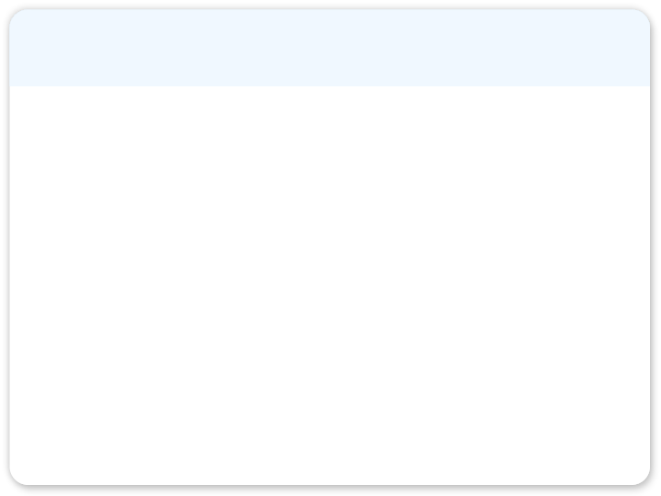
fixHeap
fixHeap(H, k) // iterative
{
int j = 1, // root of the heap
cj = 2; // left child of the root
while (cj <= currentSize)
{ // cj should be the larger child of j
    if (cj < currentSize && H[cj] < H[cj+1]) cj++;
    if ( k >= H[cj] ) break; // should put k in H[j]
    H[j] = H[cj]; // move larger child to H[j]
  j = cj; // move down one level
  cj = 2 * j; // cj is the left child of j
  }
  H[j] = k;
}
H
j
k
cj
cj + 1
1
2
3
4
5
6
7
8
9
R
P
D
F
B
K
A
C
j
cj

Slide 28
Heap Construction

Slide 29
Heap Construction
Construct a heap from an array
Start by putting all elements of the array in a heap structure in arbitrary order; then, “heapifying” the heap structure.
constructHeap(array, H)
{
  put all elements of array into a heap structure H in arbitrary order;
  heapifying(H);
  }
Uses the fixheap function
mentioned earlier

Slide 30
Heap Construction
make binary tree H become a heap
k
H
  heapifying(H)
  {
  if (H is not a leaf) {
  heapifying(left subtree of H);
  heapifying(right subtree of H);
  k = root(H);
  fixHeap(H, k);
  }
  }
L
R
make it a heap
make it a heap
Post-order traversal of a binary tree

Slide 31
Heap Construction
Assume elements in initial arbitrary order: 1 2 3 4 5 6 7
Heapify
1
1
Heapify
2
3
5
Heap is fixed
3
Heapify
4
5
6
7
4
2
6
7
1
Heapify
5
7
Heap is fixed
4
2
6
3

Slide 32
Heap Construction
1
fixHeap
1
7 swapped with 1
5
7
heap
heap
4
2
6
3
7
6 swapped with 1
Resultant array holding heap is:
7 5 6 4 2 1 3
5
6
4
2
1
3

Slide 33
Time Complexity of Heapsort

Slide 34
Time Complexity of fixHeap
fixHeap(H, k)
// recursive
{
if (H is a leaf)
// Heap has just one node
O(1)
insert k in root of H;
O(1)
else {
1 comparison
LargerSH = Sub-Heap at larger child of H’s root; O(1)
1 comparison
if (k >= LargerSH’s root key)
O(1)
insert k in root of H;
O(1)
else {
insert LargerSH’s root key in root of H;
O(1)
fixHeap(LargerSH, k);
}
}
Each recursive call moves down a level
Total no. of key comparisons ≤ 2 × tree height
}

Slide 35
Time Complexity of fixHeap
Recall: A heap is a nearly complete binary tree
1
Note: A complete binary tree of k levels has 2^{k} – 1 nodes (prove by mathematical induction)
3
2
4
5
6
7
8
9
10
9
4

Slide 36
Time Complexity of fixHeap
A heap with
1 level has ≤ 1 (= 2¹ – 1) node;
2 levels has ≤ 3 (= 2² – 1) nodes;
3 levels has ≤ 7 (= 2³ – 1) nodes;
4 levels has ≤ 15 (= 2⁴ – 1) nodes;
k – 1 levels has ≤ 2^{k–1} – 1 nodes;
k levels has ≤ 2^{k} – 1 nodes.
1
2
3
4
5
6
7
8
9
10
9
4

Slide 37

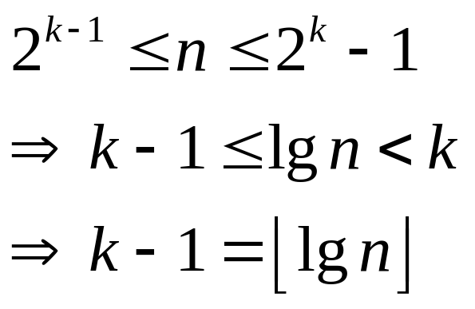
Time Complexity of fixHeap
Assume the heap has n elements, k levels:
1
2
3
4
5
6
7
8
9
10
9
4
Height of a heap with n nodes is O(lgn).
Worst-case time complexity of fixHeap is O(lgn).

Slide 38
Time Complexity of heapifying
  heapifying(H)
  {
  if (H is not a leaf)
  {
  heapifying(left subtree of H);
  heapifying(right subtree of H);
  k = root(H);
  fixHeap(H, k);
  }
  }
W(n)
O(1)
W((n-1)/2)
W((n-1)/2)
O(1)
2 lgn

Slide 39

Time Complexity of heapifying
Assume a heap is a full binary tree, i.e. n = 2^{d} – 1 for some non-negative integer d. The worst-case time complexity of heapifying(), i.e. W(n), satisfies:
Solving this equation gives W(n) = O(n) comparisons of keys in the worst-case.
(How to solve the recurrence equation is not required)

Slide 40
Heapsort Performance
best, worst, average
Heapsort(H) [O(nlgn)]
n times
constructHeap(H) [O(n)]
getMax [O(1)]
deleteMax [O(lgn)]
Heapifying(H) [O(n)]
Heapifying(leftH)
Heapifying(rightH)
fixHeap [O(lgn)]

Slide 41
Priority Queues
Priority Queues (Optional, for self-learning)
  A priority queue is a data structure for maintaining a set S of elements, each with a key value. This key is considered as the ‘priority’ of the element in S.
  Priority queues are frequently used in job scheduling, simulation systems etc.
  A priority queue supports the following operations:
    insert(x) inserts the element x into a priority queue pq.
    Maximum(pq) returns largest key from pq.
    extractMax(S) removes largest key and re-arranges pq.
  Using a heap allows an efficient way of implementing a priority queue.

Slide 42
Priority Queues
Class pq // Java code
{ private:
ALIST pq;
int N; // size of priority queue
public:
// initialisation & other methods such as EMPTY omitted
void insert (item i)
{ pq[++N] = i; fixUp(pq,N); }
item extractMax()
{ swap(pq[1], pq[N]); fixDown(pq, 1, N – 1);
return pq[ N – – ]; }
}

Slide 43
Action of Fixup
1
2
3
4
3
6
7
17
17
12
8
7
6
3
4
Insert 15
8
12
8
15
17
7
6
3
4
12
8
7
6
3
4
15

Slide 44
Action of Fixup
17
Compare 15 &17
Swap 15 & 12
12
8
17
Swap 15 & 7
7
6
3
4
15
8
15
12
6
3
4
In the worst case, comparisons from the leaf level to the root, i.e. O(lgn)
– FIXUP() complexity
7

Slide 45
Action of Fixup
The running time of insert() on an n-element heap is O(lgn) – same as fixUp()
The running time of extractMax() on an n-element heap is O(lgn) – same as fixHeap()
The running time of Maximum(pq) (i.e. getMax()) on an n-element heap is O(1) - simply gets pq[1]
So a heap can support any priority queue operation on a set of n elements in O(lgn) time

Slide 46
Heapsort (Summary)

Slide 47
Summary
Heapsort is a sorting algorithm using the data structure of heap.
A (maximising) heap is an almost complete binary tree that satisfies the (maximising) partial order tree property.
1
Y
2
3
R
P
4
5
6
7
D
F
B
K
8
9
A
C
Notes:
In the past two lectures, we have learned the Heapsort algorithm.
It is an example of the algorithm design strategy that relies on data structure.
In this case the data structure is the heap. There are maximising heaps or minimising heaps, but here we have only used the maximising heap.
A maximizing heap is defined as a binary tree that is almost complete. Specifically, every level should be complete, except for the lowest level. At the lowest level, the nodes should fill out from left to right. Moreover, a maximizing heap should satisfy the so-called “maximizing partial order tree property”, which basically says that the father node should be bigger than or equal to the children, everywhere in the tree. As a result, the root has the largest key among all the nodes in the maximizing heap. This property holds the key to the idea of Heapsort.

Slide 48
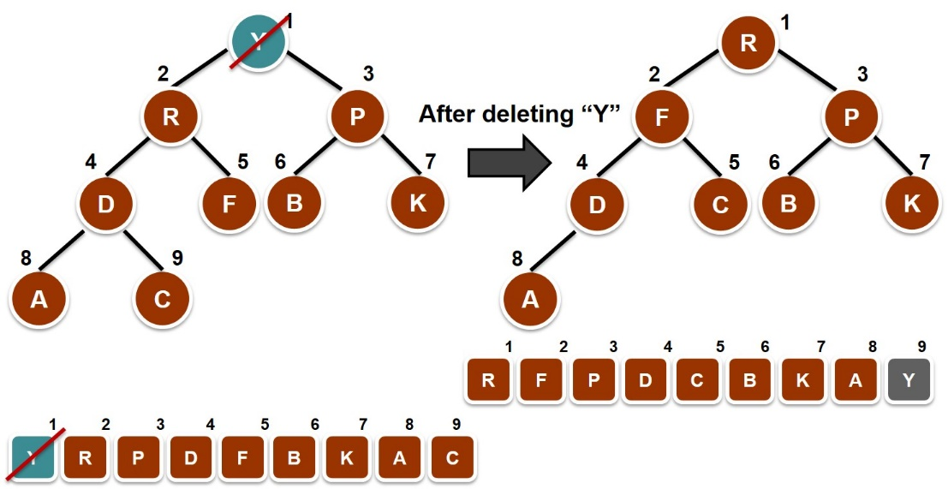
Summary
Heapsort is a sorting algorithm using the data structure of heap.
A (maximising) heap is an almost complete binary tree that satisfies the (maximising) partial order tree property.
Heapsort works by repeatedly deleting the root (maximum node) of the heap, and repair the damage (fixHeap).
Notes:
So, how does Heapsort works?
The procedure is basically to repeated removing the root, which has the maximum key value among all the nodes in the heap. Then, after deleting the root, we restore the order of the remaining nodes using a subroutine called fixHeap. It is through fixHeap we make comparisons among elements and readjust their orders, so that the damaged heap is fixed, or repaired.

Slide 49
Summary
Heapsort is a sorting algorithm using the data structure of heap.
A (maximising) heap is an almost complete binary tree that satisfies the (maximising) partial order tree property.
Heapsort works by repeatedly deleting the root (maximum node) of the heap, and repair the damage (fixHeap).
Heap is constructed by recursively calling fixHeap in a post-order traversal of the binary tree.
In worst-case, heapsort takes time Θ(nlgn), and heap construction takes linear time Θ(n).
Notes:
fixHeap is also used to construct a maximizing heap from an input array. This is a recursive procedure in post-order traversal. Basically, we fix the left subtree, then fix the right subtree, so that both sub-trees satisfy the “maximizing partial order tree property”. Then, we fix the root of the two sub-trees. This is done in a bottom-up manner.
Note that the construction of a heap is NOT the sorting. Only after the construction of a heap has been finished, we can then use the heap to do the sorting. Please be careful here not to mix them.
In the end, we have analysed the procedures involved in Heapsort. In particular, heap construction takes linear time, and the sorting takes time n log n. Since linear time is at a lower order than n log n, the overall time complexity of Heapsort is also n log n.

Slide 50
Comparison of Sorting Algorithms
Notes:
In the past few videos, we have learned four algorithms for sorting. Here, let us have a summary and compare the time complexity among the sorting algorithms.
https://www.youtube.com/watch?v=kPRA0W1kECg

Slide 51
Comparison of Sorting Algorithms
Time complexity comparison:
 | Best | Average | Worst
Insertion | n | n² | n²
Merge | n log n | n log n | n log n
Quick | n log n | n log n | n²
*Radix | n | n | n
Heap | n log n | n log n | n log n
* Radix sort is not required
Notes:
In this table, each row corresponds to an algorithm, and the three columns correspond to the best-case, average-case and worst-case time complexities.
For Insertion sort, the best case running time is linear in n, the number of elements to be sorted. Do you remember what the best case input is for the Insertion sort? The best case of Insertion sort is when the input array is already sorted. The worst-case time complexity of Insertion sort is n squared. When does the worst case happen? The worst case is when the input array is reversely sorted. We have also analyzed the average-case running time of Insertion sort, which is also big O or big theta of n squared.
Then, we learned the Mergesort algorithm, which is based on the Divide and Conquer strategy. The main idea of Mergesort is that, each time we split the input array into two halves of approximately equal sizes, and recursively we divide the arrays into smaller sub-arrays, until the sub-array is very small. Then we merge small sorted sub-arrays back to bigger sorted sub-arrays, till we get the whole array sorted by merging. For Mergesort, the best-case, average-case and worst-case, all three of them have time complexity n log n. Although we have seen some small difference in the running time of Merging for different cases of input, the overall asymptotic running time in big Oh notation would be the same, which is n log n. Here, we can see a strength of Mergesort, where its performance is quite consistent for different kinds of input.
The third sorting algorithm we have learned is, Quicksort. Like Mergesort, Quicksort also uses the Divide and Conquer approach. But instead of splitting the input array evenly at all times Quicksort split the array by comparing elements with the pivot element. Those elements smaller than the pivot will go to the left sub-list, and those elements larger than the pivot will go to the right sub-list. Then for each sub-list, we recursively apply Quicksort. The best-case running time of Quicksort is n log n. When does that happen? It happens when the pivot can always divide the input array or list into two sub-lists evenly. The worst-case time is n squared. When does that happen? The worst case happens when the pivot does a poor job in dividing the array evenly. The extreme case is when one sub-list is empty, while the other sub-list contains all the rest elements. If such loss of balance happens for each level of recursion, then it will be the worst case, with time complexity n squared. The strength of Quicksort lies in that its average-case time complexity is also n log n, which is asymptotically equal to the best case. It means that, on average, Quicksort performs almost as fast as its performance in the best case. In contrast, for Insertion sort, the average-case performance is as bad as the worst case. In practice, the overall performance often depends on the average case.
The next row is about Radix sort, but here we will not learn Radix sort. Although it has linear running time for all the three cases, Radix sort is not a general-purpose sorting algorithm, because it requires the input of key values to be within a certain range. Radix sort is different from other sorting algorithms laid out here as it is not based on comparison of keys.
The last sorting algorithm we have learned is Heapsort. The strategy of algorithm design used by Heapsort is the “Data structure” approach. The data structure used is the maximising heap. We have analysed the time complexity of Heapsort is n log n. Roughly speaking, we delete the root for n times, and each time a root is deleted, we need time log n to repair the tree, since the height of the binary tree is upper bounded by log n. Therefore, the overall running time of Heapsort is n times log n. Just like Mergesort, Heapsort has the same asymptotic running time n log n for all the three cases.

Slide 52
Empirical Comparison
Compared by time (in milliseconds)
Insertion | 0.1 | 168 | 342 | 23,382
Merge | 2.0 | 2.3 | 2.2 | 30
Quick | 0.7 | 0.9 | 0.7 | 12
*Radix | 1.6 | 1.6 | 1.6 | 18
Heap | 3.4 | 3.5 | 3.6 | 49
Up
Down
100,000 numbers
Reference: Shaffer, C. A. (2001). A practical introduction to data structures and algorithm analysis. Upper Saddle River, NJ: Prentice Hall.
‘UP’ and ‘DOWN’ columns show the performance for inputs of size 10,000 where the numbers are in ascending (sorted) and descending (reversely sorted) order. Figures are timings obtained using workstation
running UNIX.
Notes:
This slide shows empirical time analyses of the sorting algorithms. That is, we measure the CPU times used by the algorithms in a real computer, which is a workstation under Unix operation system. The time unit is millisecond. In the first column of data, labeled by “UP”, the input was ten thousand numbers in ascending order. In the column labeled with “DOWN”, the input data are ten thousand numbers in descending order. They are decreasing. The algorithms are supposed to sort the numbers in ascending order. The column between “UP” and “DOWN” columns contains CPU time for input numbers that are in random order. For the last column, the input are one hundred thousand numbers in random order.
As we can see from the table, Insertion sort is indeed very fast when the input numbers are already sorted, because that is the best case for Insertion sort. However, when the input numbers are reversely sorted, then the performance of Insertion sort is very bad. It takes much longer than all the other algorithms. We can see that the empirical observation agrees with our theory about the running time. When input numbers are in random order, as shown in the column between “UP” and “DOWN”, we can see that Insertion sort also has very poor performance. Likewise, for the larger input data with one hundred thousand numbers, Insertion sort is much slower than other algorithms. But for Mergesort, we can see that the performance is quite consistent. It has almost equally good performance for all the three input cases. The speed of Quicksort is really impressive. It is much faster than all the other algorithms in most cases, except for the best case of Insertion sort. What is nice about Quicksort is that, it is not easy to find the worst-case input for Quicksort. For Heapsort, it is consistently good, when compared with Insertion sort. But it has quite some overhead, which is measured by the constant multiplier in the big Oh notation. One reason is that we need to maintain the data structure of maximising heap, which will incur some overhead cost. But like Mergesort, Heapsort is quite reliable, meaning that it performs consistently well for different kinds of input data. On a whole, we can see that the empirical analyses of CPU times of the sorting algorithms agree with our theoretical analysis of the time complexity. That means our mathematical analysis of the sorting algorithms has good predictive power about their real performances.

